Slide 1

Default of Credit Card Clients
Danny Grozdev, Alexa Asis, Corey Jordan-Zamora, Preeti Sharma, Peter Szczepanski
DePaul University
DSC324/424 Advanced Data Analysis

Slide 2
Introduction
What is Credit Card Default?
Cardholder fails to meet payment obligations → did not pay the minimum required credit card payments
Not bankruptcy
Can severely damage credit scores → lead to legal action/account closure if the default continues over time
Why Does it Matter?
Accurately predicting default helps banks manage risk and prevent losses
Lenders can identify risky clients early, make smarter lending decisions, and keep the financial system stable
What Was Happening at That Time?
In 2005, Taiwan experienced rapid growth in credit card usage, and rising consumer debt became a concern
Borrowers faced high credit card balances → led to increase in defaults and a closer examination of lending practices (Yeh & Lien, 2009)

Slide 3
Literature Review
Prediction models for business credit decisions have proved to be impactful for the banking industry (Arora et al., 2022)
Crucial in identifying credit lending and credit risk assessment issues
Hamdy & Hussein (2016) state that credit risk assessment is crucial for credit lending decision-making
Credit scoring models classify applicants into two groups: applicant with good credit, or applicant with bad credit
Models use application information and applicant information held by a credit reference agency to classify
Ince & Aktan (2009) conclude that credit scoring systems aid in controlling bad debt losses
Systems are used to model potential risks of credit card applicants

Slide 4
Research Questions
Main Research Question:
What factors predict credit card default, and how influential are they?
Sub Research Questions:
CCA: Is there a relationship between a customer's demographic/financial profile and repayment behavior?
EFA: Are there underlying patterns in consumer demographics and repayment behaviors?

Slide 5
Methods
Stepwise binary logistic regression
For data exploration
To build our predictive model for default payment.
Logistic regression + Principal Component Analysis
To simplify model by grouping related variables into principal components
Canonical Correlation Analysis (CCA)
To examine the relationships between two conceptually meaningful groups of variables from our dataset:
Client Profile/Credit Info
Payment Behavior
PCA
To explore potential latent structures relevant to predicting client default behavior
Exploratory Factor Analysis (EFA)
To identify latent dimensions across nine standardized variables: payment history, age, education level, and marital status

Slide 6
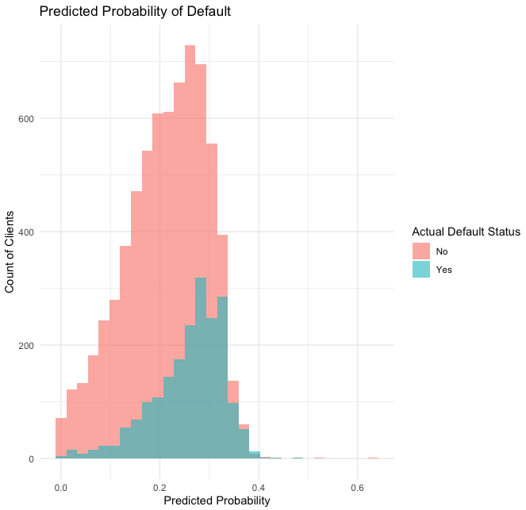
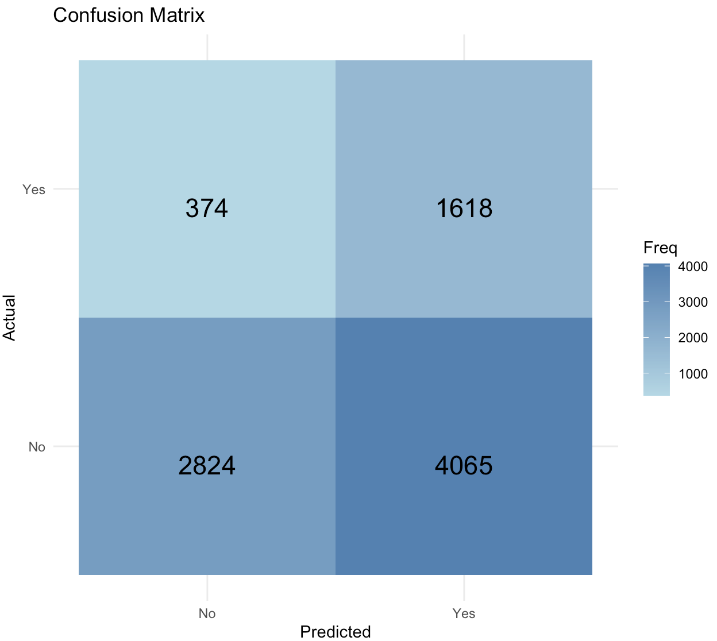
Results – 1st Stepwise Binary Logistic Regression
Probability Histogram
Confusion Matrix Heat Map
Key Takeaway: The model is best utilized to flag high-risk clients but can predict the probability of default for low-risk clients as well. Model can differentiate between default and non-default clients.
Key Takeaway: The model predicts non-default clients relatively well, in comparison to default clients. This may pose risks for lenders, as the model has difficulty in accurately predicting default clients.

Slide 7
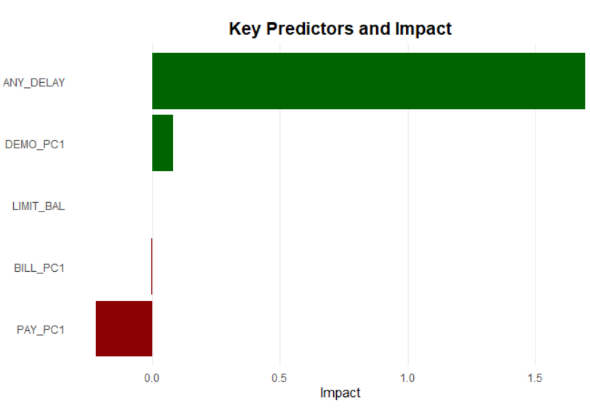
Results – 2nd Logistic Regression + PCA
ANY_DELAY: Whether a client ever delayed payment on any billing cycle
BILL_PC1: Overall billing pattern over time
DEMO_PC1: Combines age, education, marital status, and gender
LIMIT_BAL: The total credit limit available to the client
PAY_PC1: Overall payment behavior over time
Sensitivity: 83.78% correctly predicted on non-defaulters
Specificity: 51.39% correctly predicted on defaulters
All variables are significant, with ANY_DELAY being the strongest predictor! PAY_PC1 shows the largest negative impact, where better payment behavior over time reduces the likelihood of default. Outliers are present, but there are no signs of multicollinearity
Key Takeaway: The model achieves a balanced accuracy of ≈ 76% and AUC of 0.73, indicating reasonable performance for predicting defaults.

Slide 8
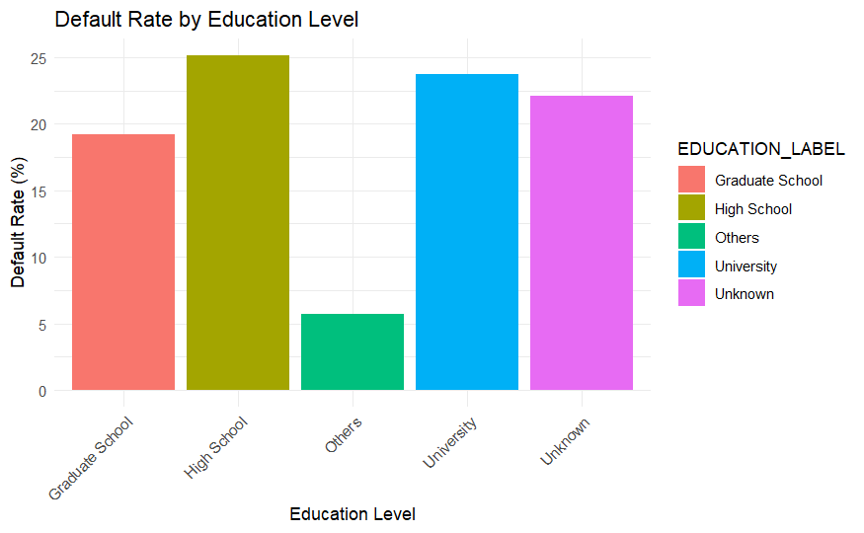
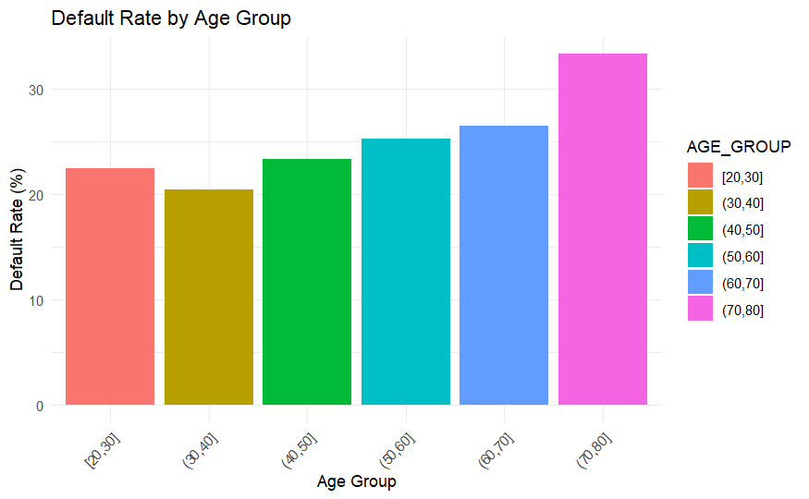
Results – Relationship Insights
Having a graduate school education reduces the likelihood of default.
As one ages, the risk of default increases.

Slide 9
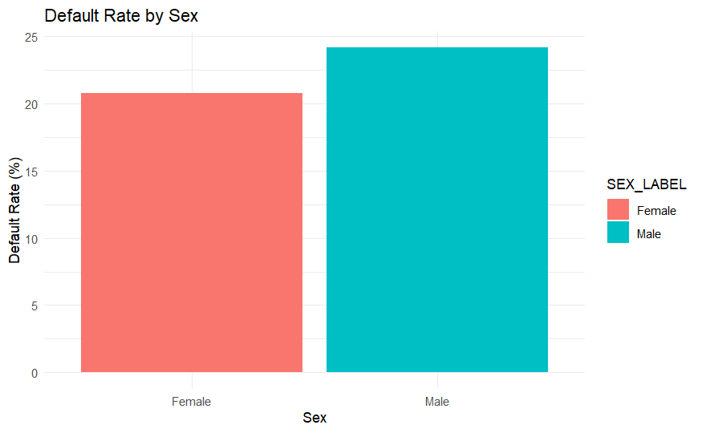
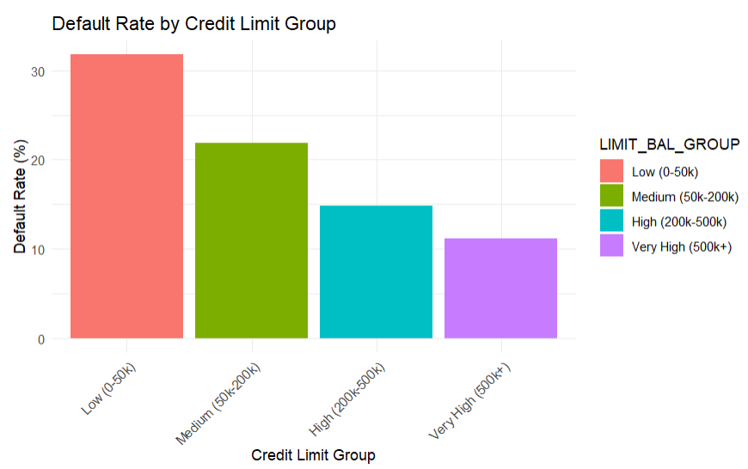
Results – Relationship Insights
Females are less likely to default.
A higher credit limit decreases the chance of default.

Slide 10
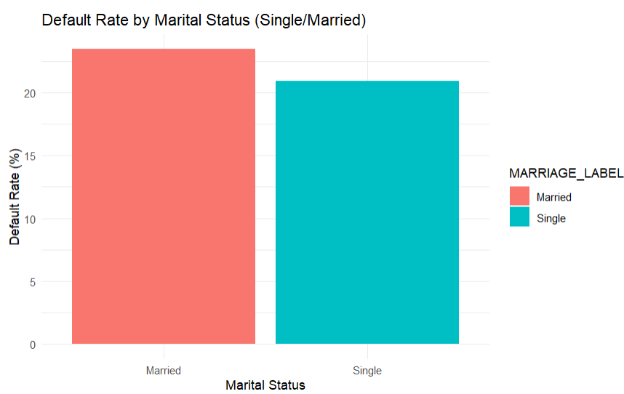
Results – Relationship Insights
Being single lowers the likelihood of default.

Slide 11
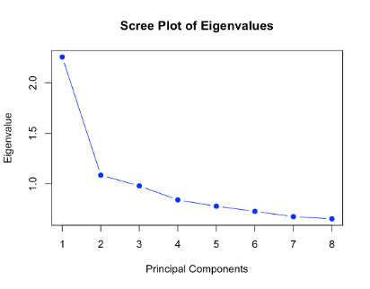
Results PCA
Eigenvalues
PC1 | 2.26
PC2 | 1.09
PC3 | 0.98
PC4 | 0.84
PC5 | 0.78
PC6 | 0.73
PC7 | 0.68
PC8 | 0.66
PC1 captures 28.19% information
PC2 captures 13.57% information
The scree plot indicates -> retention of two principal components

Slide 12
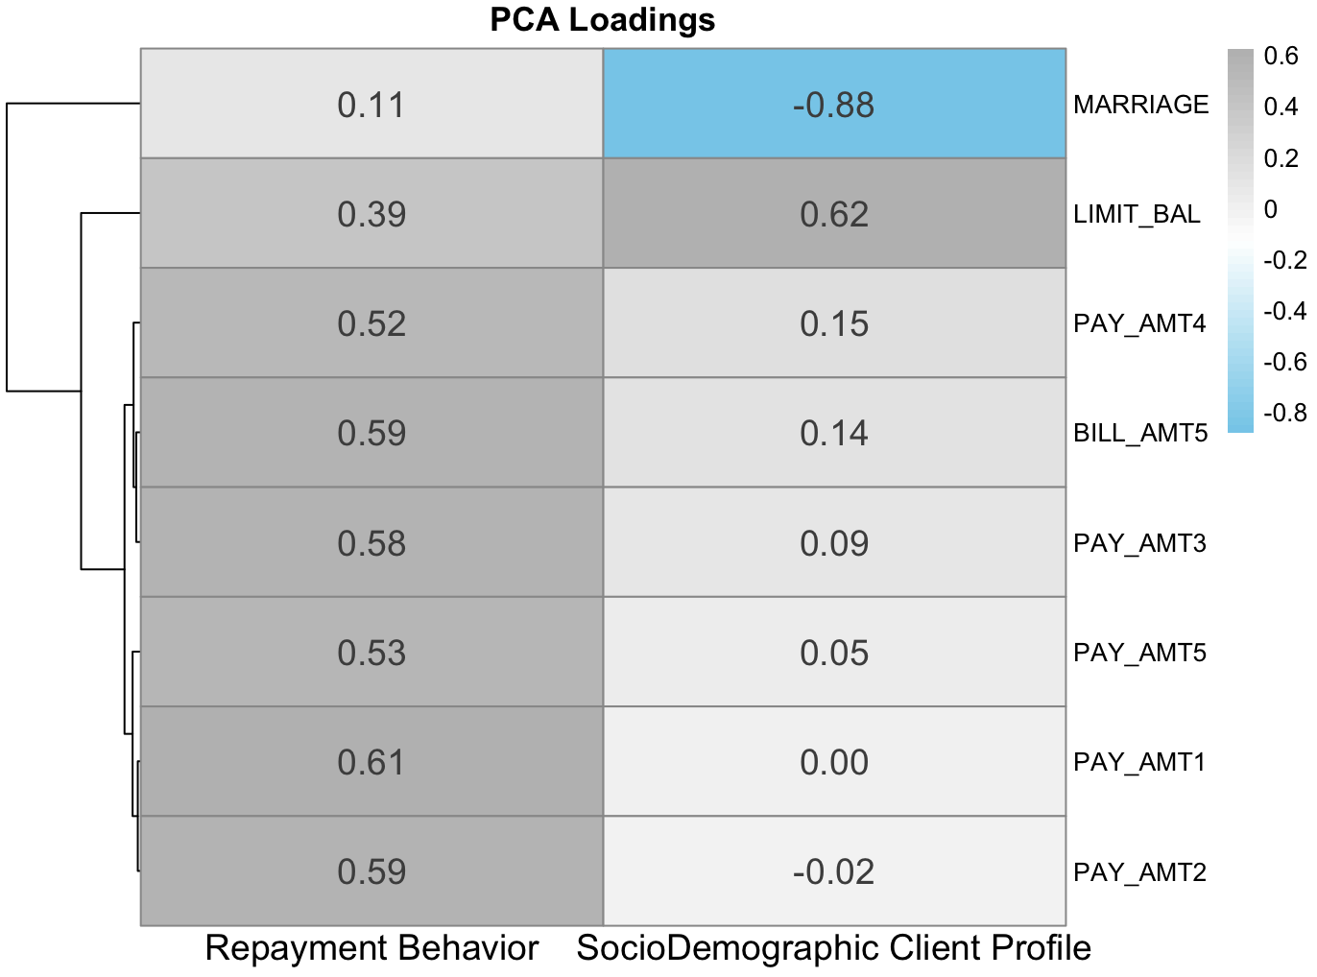
Results - PCA
Key Takeaways:
Components identify general behavioral and demographic patterns
Repayment Behavior -> the strongest influence on default.
Components explain ~42% variance

Slide 13
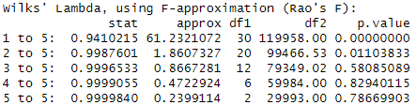
Results - CCA
We used CCA to explore links between client background (age, sex, education, marital status, credit limit) and repayment behavior.
A weak but statistically significant relationship was found (first canonical correlation ≈ 0.24).
Credit limit had the strongest positive influence, associated with better repayment behavior.
Late payments were negatively associated, reinforcing their role in default risk.
Demographic variables (age, education, marital status) played a smaller role.
Results suggest that repayment behavior is better explained by financial variables and richer behavioral variables, than just by demographics alone.

Slide 14
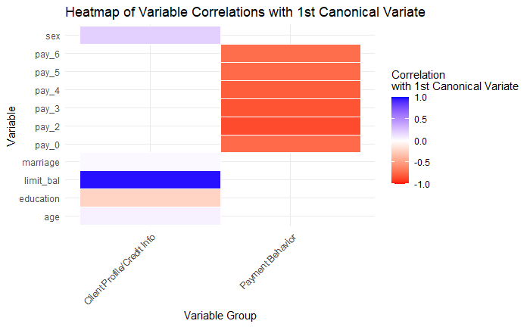
Results - CCA - Heatmap
The heatmap shows a clear contrast: clients with higher credit limits and timely payments load positively, while those with frequent delays and lower limits load negatively on the first canonical dimension.

Slide 15
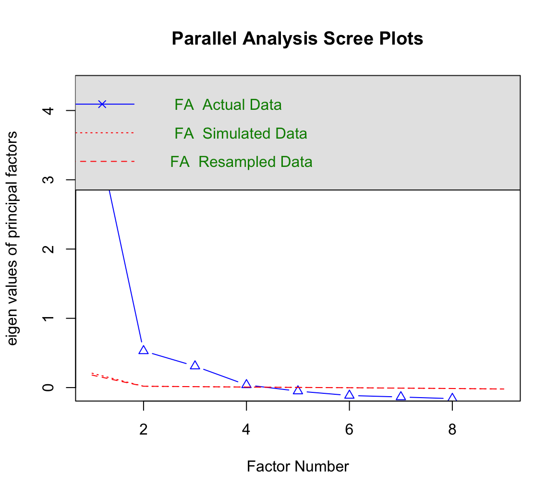
Results - EFA
This scree plot illustrates the eigenvalues from our EFA.
Each point represents the amount of variance explained by a given factor.
The elbow of the plot appears after the fourth factor suggesting that only the first four factors explain substantial variance.

Slide 16
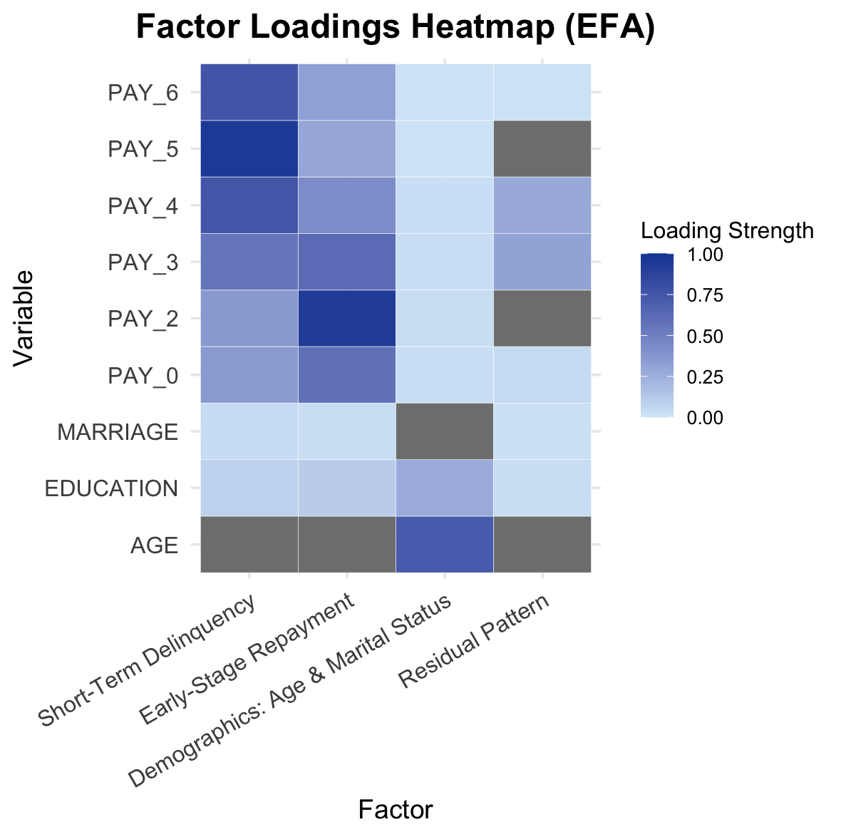
Results - EFA
This heat map illustrates the loadings from our EFA → identify how strongly each original variable correlates with each of the four extracted factors.
The top left corner highlights strong positive loadings for PAY_4 to PAY_6 on Factor 1, Short-Term Delinquency.
PAY_0 through PAY_3 show strong associations with Factor 2, Early-Stage Repayment.
AGE and MARRIAGE load on Factor 3, demographic structure.
These patterns confirm that our variables cluster into meaningful themes.

Slide 17
Limitations
Dataset included multiple variables with undefined levels → decreased our sample size and excluded variables from analysis
Affected model predictive performance for target variable
Posed risk regarding accurate prediction of default versus non-default cases
Certain techniques assume linearity and multivariate normality → did not hold perfectly in our data.
Simplified and hid relationships and interactions in our data
Limited capability to fully capture aspects relevant for accurate classification

Slide 18
Future Work
Treat variables with undefined levels differently → may result in more accurate predictive models
Additional analysis techniques to analyze client demographics and credit behavior → uncover more relationships and patterns
Exploring time-based features and behavioral variables
Ex: total bill amount to repayment-to-bill ratio
Can refine variable relationship analysis for credit card data
Utilize decision trees or random forests → may better capture additional patterns credit card data

Slide 19
Conclusion
1. Demographic and behavioral factors can predict default risk, but to a limited degree.
While behavioral factors like age or education help describe clients, they are not strong predictors of default without keeping financial behavior in mind.
2. Different techniques provide complementary insights.
We explored the data from multiple angles, uncovering both broad behavior patterns and meaningful client groupings. Together, these perspectives helped reveal how lifestyle habits and financial behavior relate to default risk.
3. Broader and deeper data is needed for better prediction.
Better prediction requires broader information, such as spending behavior, income, past balance, bill amount, and other financial habits, to capture the full picture of client risk.

Slide 20
References
Arora, S., Bindra, S., Singh, S., & Kumar Nassa, V. (2022). Prediction of credit card defaults through data analysis and Machine Learning Techniques. Materials Today: Proceedings, 51, 110–117. https://doi.org/10.1016/j.matpr.2021.04.588
Chang, C. (2022). Information asymmetry and card debt crisis in Taiwan. Bulletin of Applied Economics, 9(2), 123-145. https://doi.org/10.47260/bae/927
Crook, J. N., Edelman, D. B., & Thomas, L. C. (2007). Recent developments in Consumer Credit Risk Assessment. European Journal of Operational Research, 183(3), 1447–1465. https://doi.org/10.1016/j.ejor.2006.09.100
Hamdy, A., & Hussein, W. B. (2016). Credit risk assessment model based using principal component analysis and Artificial Neural Network. MATEC Web of Conferences, 76, 02039. https://doi.org/10.1051/matecconf/20167602039
Hardoon, K. K., Gupta, R., & Derevensky, J. L. (2004). Psychosocial variables associated with adolescent gambling. Psychology of Addictive Behaviors, 18(2), 170–179. https://doi.org/10.1037/0893-164x.18.2.170
Ince, H., & Aktan, B. (2009). A comparison of data mining techniques for credit scoring in banking: A managerial perspective. Journal of Business Economics and Management, 10(3), 233–240. https://doi.org/10.3846/1611-1699.2009.10.233-240

Slide 21
References
Jolliffe, I. T. (2002). Principal component analysis: With 28 illustrations. Springer.
LUSARDI, A., & TUFANO, P. (2015). Debt literacy, financial experiences, and overindebtedness. Journal of Pension Economics and Finance, 14(4), 332–368. https://doi.org/10.1017/s1474747215000232
Rosenberg, E., & Gleit, A. (1994). Quantitative methods in credit management: A survey. Operations Research, 42(4), 589. https://doi.org/10.1287/opre.42.4.589
Šarlija, N. i Jeger, M. (2011). COMPARING FINANCIAL DISTRESS PREDICTION MODELS BEFORE AND DURING RECESSION. Croatian Operational Research Review, 2 (1), 133-142. Preuzetos https://hrcak.srce.hr/96658
Yeh, I.-C., & Lien, C.-H. (2009). The comparisons of data mining techniques for the predictive accuracy of probability of default of credit card clients. Expert Systems with Applications, 36(2), 2473–2480. https://doi.org/10.1016/j.eswa.2007.12.020

